Slide 1

Tior Games Data Warehouse
By H.A.M

Slide 2
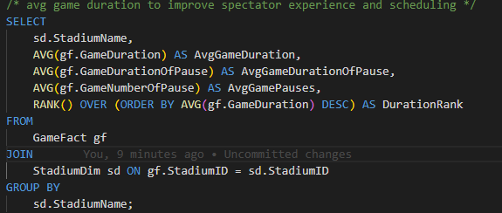
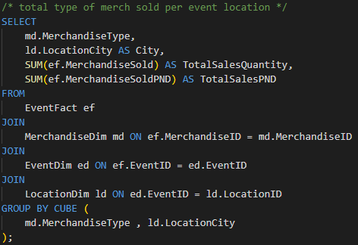
T-SQL Queries
Query 1
Query 2
This query looks at the total type of merch sold per event location.
Tior games can adjust inventory distribution of the merchandise type to maximise sales.
In the 2nd query we look at the average game duration.
This helps in optimising scheduling and spectator engagement.

Slide 3
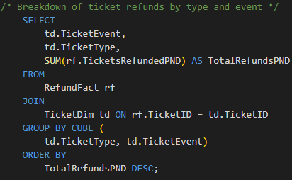
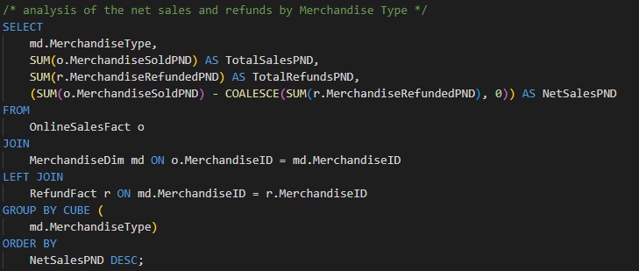
T-SQL Queries - cont
Query 3
Query 4
We go on to explore the net sales by merchandise type.
Tior games could decide to discontinue low-net sale items and focus on high profitable products.
We get to have a breakdown of ticket refunds.
Prices and policies could be adjusted and perks added to high-refund events.

Slide 4
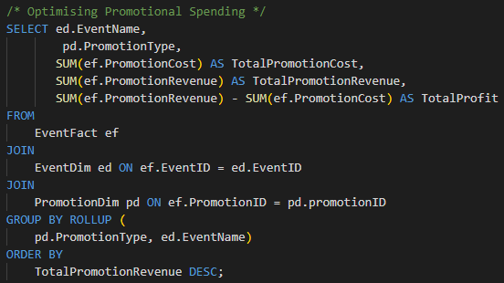
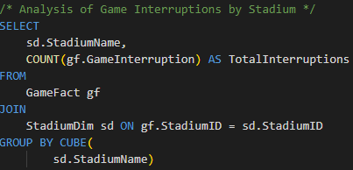
T-SQL Queries - cont
Query 5
Query 6
We give a closer look to promotional costs and revenue.
Tior games can see ROI of promotional efforts and better understand the financial impact.
We get to see the amount of game interruptions by stadium.
We can further investigate if factors like referee decisions, technical pauses could be affecting it. Also, could be a performance evaluation criteria for referees.

Slide 5

Schema Enhancements
To ensure better meta tracking and game balance insights, I produced the following enhancements;
PatchDim to track gameplay adjustments
ChampionBanRateDim to identify different how champions are used
MetaImpactFact to quantify how patches affect champion viability in competitive play.
With this, teams can adjust based on meta trends, ensures balanced gameplay and spectators get to enjoy dynamic and evolving strategies

Slide 6
Data Dictionary
Table | Attribute | Data Types | Identifier | Notes
PatchDim | PatchID | Int | PK | Unique patch identifier
 | Version | Decimal |  | Patch number (example, "13.4")
 | ReleaseDate | Date |  | Date the patch went live
 | BalanceChanges | Str |  | Summary of key gameplay changes
ChampionBanRateDim | BanRateID | Int | PK | Unique identifier for ban rate records
 | ChampionKey | Int | FK | References ChampionDim
 | BanRatePercentage | Int |  | % of games where the champion was banned
 | PatchKey | Int | FK | References PatchDim
MetaImpactFact | PatchKey | Int | PK/FK | References PatchDim
 | ChampionBanRateKey | Int | PK/FK | References ChampionBanRateDim
 | GameKey | Int | PK/FK | References GameDim
 | WinRateChange | Int |  | Difference in win rate post-patch (eg 5)
 | PickRateChange | Int |  | Difference in pick rate post-patch

Slide 7
ETL and Data Integration
Using python and the panda library for ETL process.
Extracting data from excel and json can be done with pandas.read_excel and pandas.read_json respectively.
These can then be combined into one data frame using the concat function.
From here on, we can start transforming the data by dropping null values from columns where null values are not expected with the pd.dropna() function.

Slide 8
ETL and Data Integration - cont
By creating a map with keys as column names and values as their respective data types, we can loop through the data frame and either try convert them to correct data types or skip the record altogether.
For valid dates, we can cross check with the DateDim and TimeDim to ensure that they exist and only accept those with the year 2024.
Foreign key validation would be done by running joins and checking whether they exist in the given dimension otherwise drop the record.

Slide 9

ETL and Data Integration - cont
Insert query
INSERT INTO GameFact (EventID, StadiumID, RefereeID, GameID, TimeID, DateID, PauseID, HighlightID, GameDuration, GameNumberOfPause, GameTeam, GameInterruption, GameMinuteOfPause, GameDurationOfPause, GameResult) VALUES ()

